Slide 1
Body Fat Prediction
Your Path to a Healthier You
Group 7: Wanxin Tu, Ziming Li, Baiheng Chen

Slide 2
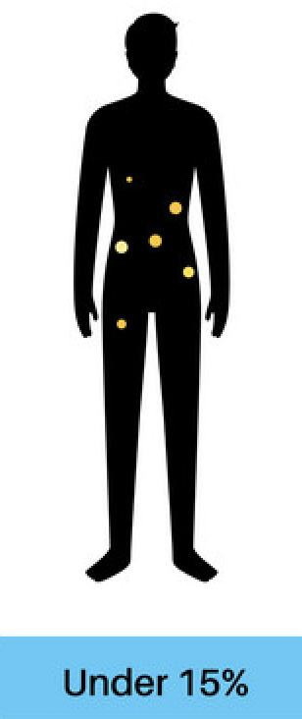
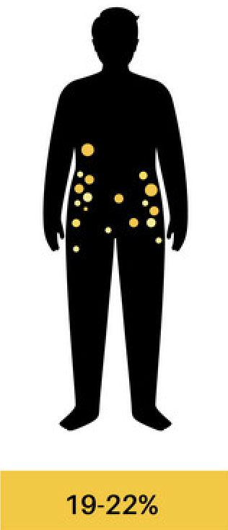
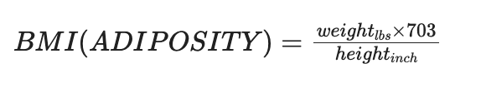
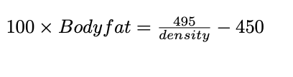
Introduction & Data Cleaning
Energy storage, insulation, and protection of vital organs
Weight Management
Health and Disease Risk
Notes:
Body fat is an essential component of our body.
Monitoring and managing body fat are essential for weight managemet, maintaining healthy and reducing the risk of various health conditions,like obesity, diabetes, and heart disease.
We have two model option in our website, first we only need 3 input,

Slide 3
Replacement:
Deletion:
Final cleaned data: n = 249(from 252)
Individual | Original obs. | Fixed obs. | Method
‘HEIGHT’ | 29.5 inches | 69.50 inches | BMI formula
Individual | Original obs. | Value by Calculation | Method
‘BODYFAT’ | 0.0% | 0.69% | Body fat formula
‘BODYFAT’ | 1.9% | -3.611% | Body fat formula
‘BODYFAT’ | 45.1% | 47.48% | Body fat formula

Slide 4
Final Models
Define the best models by:
Number of inputs
Adjust R square and RMSE on the training set
Prediction error on the test set
Performance:
AIC Model(R2=0.751, RMSE=3.74), 11 inputs
3-features model(R2=0.729, RMSE=4.01), 3 inputs: Abdomen, Wrist, Weight

Slide 5
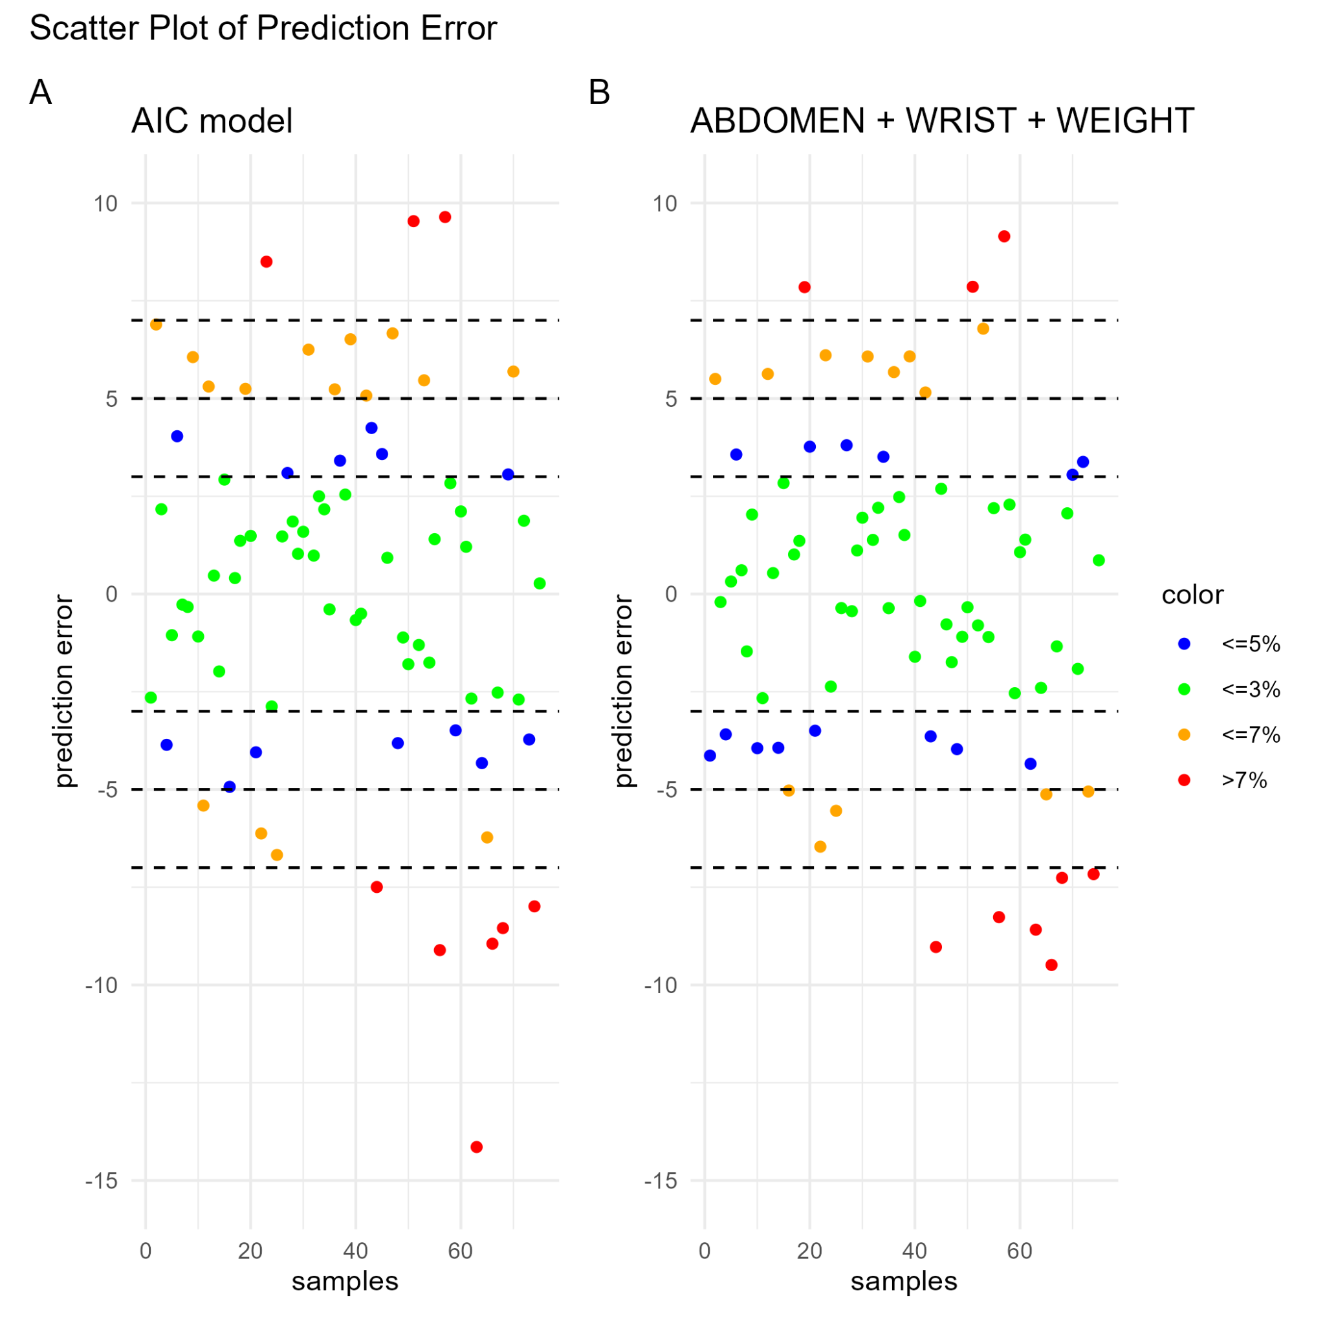
Prediction Error of Final Models

Slide 6
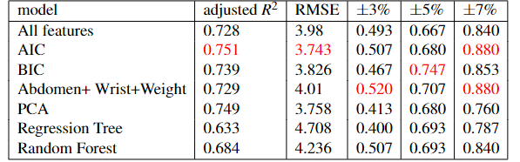
Model Construction

Slide 7
Discussion and Improvement
Bias data (gender, age)
More features (diet)
Sample size

Slide 8
Get Started!
Our shinny

Slide 9
Q & A

